Slide 1
TEAM 4 Capgemini MIPL, Chennai 10th August 2018

Slide 2
Java-FLP project – CapStore
(E-commerce - application)

Slide 3
TEAM MEMBERS
SUSHMITHA S.H (TEAM LEAD)
SARATH NISTALA
VIKAS KUMAR ROY
YAMINI AMBATI

Slide 4


MODULE 17 - SEARCH
Search will be available on all pages of CapStore.
Admin, Customer can search about Products and brands . Search can be Category wise, name wise or type.
Merchant can search products available in its own inventory only.
Notes:
O Logo de espadas deve ter mais espaço das pontas abaixo. Sugerir outros tipos de imagens/ telefone, fones.

Slide 5
Tables search function is dependant on:
Click to insert title
If a customer, merchant or admin wants to search products, then they need to use the search box.
For search to be made category wise, name wise or type wise, search will be dependant on category table. To access only from particular inventory, then inventory table is needed.
Customer, Merchant and Admin
Inventory, category
Notes:
Fixar a posicao do titulo – sempre do lado esquerdo.
Sempre que tiver muito texto o coluna deve sempre ser “ narrowed” , se nao fica dificil de ler. Colocar paragrafos no texto.
Linha vertical deve ser mais fina e as pontas NUNCA devem ser arredondadas.

Slide 6
MODULE 18 – IMAGE UPLOAD
Admin and Merchant can upload images of products and banners .
Notes:
O Logo de espadas deve ter mais espaço das pontas abaixo. Sugerir outros tipos de imagens/ telefone, fones.

Slide 7
Tables image upload function is dependant on:
Click to insert title
Click to insert title
Inventory
Will fetch the products availble in the table and upload images for them
IMAGE UPLOAD
Int: imageId
Int: productId
Varchar: imageURL
PK
FK
Notes:
Fixar a posicao do titulo – sempre do lado esquerdo.
Sempre que tiver muito texto o coluna deve sempre ser “ narrowed” , se nao fica dificil de ler. Colocar paragrafos no texto.
Linha vertical deve ser mais fina e as pontas NUNCA devem ser arredondadas.

Slide 8
MODULE 19 – PRODUCTS IMAGES
TABLES PRODUCT IMAGES IS DEPENDANT ON:
Inventory Initiate zoom effects and slideshow view for the products selected.
Images can be zoomed and will be displayed in proper slideshow.
Notes:
O Logo de espadas deve ter mais espaço das pontas abaixo. Sugerir outros tipos de imagens/ telefone, fones.

Slide 9
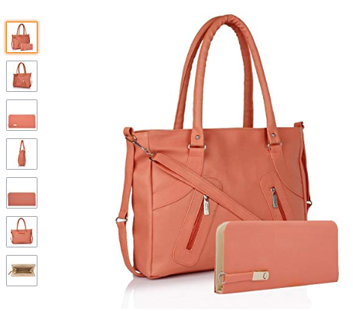
O O O O O O O

Slide 10
MODULE 20 - DISCOUNT, PROMOS
DISCOUNT
Int: discountId
String: discountPercent
Localdate: IssueDate
Localdate: expiryDate
Admin and Merchant can put up promos and discount, it can be on individual products or for category of products or on some minimum amount & It will be for a limited time period.
PK
Notes:
O Logo de espadas deve ter mais espaço das pontas abaixo. Sugerir outros tipos de imagens/ telefone, fones.

Slide 11
IMAGE UPLOAD TABLE
Column name | Data type | Constraint | Description
imageId | int | Primary key | Used to identify image
productId | int | Foreign key
imageURL | varchar | Not null

Slide 12
DISCOUNT TABLE
Column name | Data type | Constraint | Description
discount Id | int | Primary key | Used to identify discount
discountPercent | varchar | Not null | Used to calculate discount %
issueDate | localDate | Not null
expiryDate | localDate | Not null

